Slide 1
Chapter 1
Introduction to computer programming
Computer Science Department
Jordan University of Science and Technology

Slide 2
Chapter 1 Objectives
After completing this module, the student will be able to:
Explain how a sample C++ program works
Explain the concept of integers, floating-point numbers, operators and arithmetic operations in C++ programming
Discover and fix basic syntax errors
Modify the structure of a C++ program
Perform basic calculations
Understand the precedence and associativity of C++ operators and the proper use of parentheses
Use the shortcut and pre/post increment/decrement operators
Build simple expressions
Translate verbal description into programming language
Test code using known input and output data
Compare values using relational operators
Build Boolean expressions using logical operators

Slide 3
1.1 Different languages for different purposes

Slide 4

1.1 Natural language vs. programming language

Slide 5
1.1 Natural language vs. programming language
What is a language?
a language is a tool for expressing and recording human thoughts
What is a programming language?
A programming language is defined by a certain set of rigid rules, these rules determine which symbols (letters, digits, punctuation marks, and so on) could be used in the language

Slide 6
1.1 Natural language vs. programming language
Any programming language consists of:
Syntax: is a set of rules determines the appropriate ways of collating the symbols
Semantic: the ability to recognize the meaning of every statement expressed in the given language
Any program we write must be error-free in these three ways: lexically, syntactically and semantically, otherwise, the program won’t run, or it will produce unacceptable results

Slide 7
1.1 Natural language vs. programming language
Why we need to use a programming language?
The machine language is the simplest and the most primary language we can use to give commands to our computer (very difficult to understand for humans)
A high-level programming language is a bridge between the people's language (natural language) and computer language (machine language)
A high-level programming language is similar to a natural language: it uses symbols, words and conventions readable to humans.
High-level languages include Basic, FORTRAN, COBOL, Pascal, C, C++, C#, and Java

Slide 8
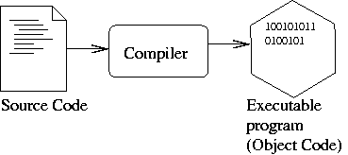
1.1 Natural language vs. programming language
Compiler: a specialized computer program translates a program written in a high-level language to machine language

Slide 9
1.2 Your first program

Slide 10
Processing a C++ Program
C++ Programming: From Problem Analysis to Program Design, Fifth Edition
#include <iostream>
using namespace std;
int main()
{
cout << "My first C++ program." << endl;
return 0;
}
Sample Run:
My first C++ program.

Slide 11
Processing a C++ Program (cont'd.)
C++ Programming: From Problem Analysis to Program Design, Fifth Edition
To execute a C++ program:
Use an editor to create a source program in C++
Preprocessor directives begin with # and are processed by the preprocessor. (A set of preliminary information that the compiler needs is included in header files such iostream header file)
Use the compiler to:
Check that the program obeys the rules
Translate into machine language (object program)
Linker:
Combines object program with other programs provided by the SDK to create executable code
Loader:
Loads executable program into main memory
The last step is to execute the program

Slide 12
Processing a C++ Program (cont'd.)
C++ Programming: From Problem Analysis to Program Design, Fifth Edition

Slide 13
Programming with the Problem Analysis–Coding–Execution Cycle
C++ Programming: From Problem Analysis to Program Design, Fifth Edition
Programming is a process of problem solving
One problem-solving technique:
Analyze the problem
Outline the problem requirements
Design steps (algorithm) to solve the problem
Algorithm:
Step-by-step problem-solving process
Solution achieved in finite amount of time

Slide 14
The Problem Analysis–Coding–Execution Cycle
C++ Programming: From Problem Analysis to Program Design, Fifth Edition

Slide 15
The Problem Analysis–Coding–Execution Cycle (cont'd.)
C++ Programming: From Problem Analysis to Program Design, Fifth Edition
Run code through compiler
If compiler generates errors
Look at code and remove errors
Run code again through compiler
If there are no syntax errors
Compiler generates equivalent machine code
Linker links machine code with system resources

Slide 16
The Problem Analysis–Coding–Execution Cycle (cont'd.)
C++ Programming: From Problem Analysis to Program Design, Fifth Edition
Once compiled and linked, loader can place program into main memory for execution
The final step is to execute the program
Compiler guarantees that the program follows the rules of the language
Does not guarantee that the program will run correctly

Slide 17
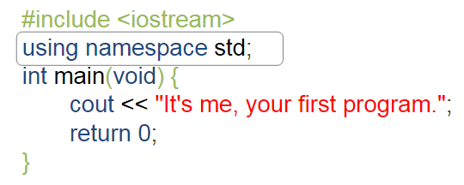
1.2 Your first program
Preprocessor directives are commands supplied to the preprocessor
All preprocessor commands begin with #
A set of preliminary information that the compiler needs is included in header files such iostream header file.

Slide 18
1.2 Your first program
In C++ language, all elements of the standard C++ library are declared inside std namespace
A namespace is an abstract container to hold a logical grouping of unique entities (blocks).

Slide 19
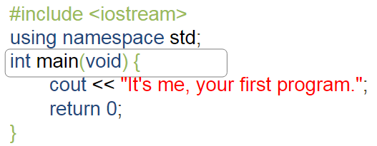
1.2 Your first program
C++ language assumes that a program must always have a function named main
The function body begins with the first opening bracket { and ends with the corresponding closing bracket }

Slide 20
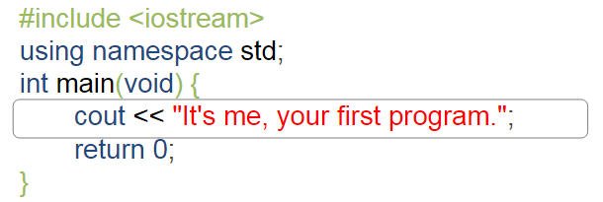
1.2 Your first program
Each instruction (statement) in C++ must end with a semicolon
The cout entity (object) must be fed with something that is intended to be shown on the screen.
In our example, the feed is just text (string).
Strings in the program in C++ are always enclosed in quotes

Slide 21
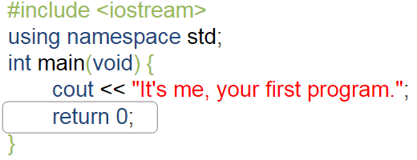
1.2 Your first program
The return statement causes the end of function execution
The zero after the word return is how your program tells the operating system that the program performed successfully

Slide 22
1.2 Activities
Lab 1.2.6 (1) Your first program [A]

Slide 23
1.3, 1.4, 1.5 Data Types, variables and Operators

Slide 24
Comments
Comments are for the reader, not the compiler
To explain to other readers of the code how the tricks used in the code work
To explain the means of variables and functions
To document who the author is and when the program was written
Whenever the compiler encounters a comment in your program, the compiler will skip it to the end of the comment.
Two types:
Single line
// This is a C++ program. It prints the sentence:
// Welcome to C++ Programming.
Multiple line
/*
You can include comments that can
occupy several lines.
*/

Slide 25
Special Symbols
Special symbols
+
-
*
/
.
;
?
,
<=
!=
==
>=

Slide 26
Reserved Words (Keywords)
C++ Programming: From Problem Analysis to Program Design, Fifth Edition
Reserved words, keywords, or word symbols
Include:
int
float
double
char
const
void
return

Slide 27
Whitespaces
Cout<< “2” <<“3”; //23
Cout<<“ 2 “<<“3”; // 2 3
C++ Programming: From Problem Analysis to Program Design, Fifth Edition
Every C++ program contains whitespaces
Include blanks, tabs, and newline characters
Used to separate special symbols, reserved words, and identifiers
Proper utilization of whitespaces is important
Can be used to make the program readable

Slide 28
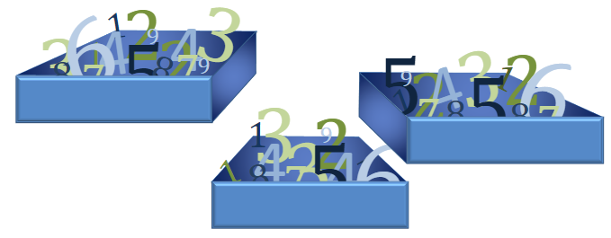
1.3 Variables
Variables: are special “containers” used to store the results of C++ operations in order to use them in other operations
As the name variables suggests, the content of a container can be varied

Slide 29
1.3 Variables (identifiers)
Consist of letters, digits, and the underscore character (_)
Must begin with a letter or underscore
C++ is case sensitive
NUMBER is not the same as number
Two predefined identifiers are cout and cin
Unlike reserved words, predefined identifiers may be redefined, but it is not a good idea
C++ Programming: From Problem Analysis to Program Design, Fifth Edition

Slide 30
C++ Programming: From Problem Analysis to Program Design, Fifth Edition
Legal variables (identifiers) in C++:
first
conversion
payRate

Slide 31
C++ variables have:
a name
a type
a value
The variable exists as a result of a declaration
A declaration is a syntactic structure that binds a name provided by the programmer with a specific type
Type then variable name (or variable names separated by commas if there are more than one)
Ends with a semicolon
int Counter;
int variable1, account_balance, invoices;

Slide 32
The type is an attribute that uniquely defines which values can be stored inside the variable.
To give a value to the newly declared variable, assignment operator is used.
Examples:
Counter = 1; → assign 1 to Counter or Counter becomes 1.
Result = 100+ 200; → the new value of the variable Result will be the result of adding 100 to 200
X= X + 1; → Take the current value of the variable x, add 1 to it and store the result in the variable x. In effect, the value of variable x is incremented by one.

Slide 33
Data Types
C++ Programming: From Problem Analysis to Program Design, Fifth Edition
Data type: set of values together with a set of operations
C++ data types fall into three categories:

Slide 34
Simple Data Types
C++ Programming: From Problem Analysis to Program Design, Fifth Edition
Three categories of simple data
Integral: integers (numbers without a decimal)
Floating-point: decimal numbers
Enumeration type: user-defined data type

Slide 35
Simple Data Types (cont'd.)
C++ Programming: From Problem Analysis to Program Design, Fifth Edition
Integral data types are further classified into nine categories:
char, short, int, long, bool
unsigned char, unsigned short, unsigned int, unsigned long

Slide 36
Simple Data Types (cont'd.)
C++ Programming: From Problem Analysis to Program Design, Fifth Edition
Different compilers may allow different ranges of values

Slide 37
int Data Type
C++ Programming: From Problem Analysis to Program Design, Fifth Edition
Examples:
-6728
0
78
+763
Positive integers do not need a + sign
No commas are used within an integer
Commas are used for separating items in a list

Slide 38
bool Data Type
C++ Programming: From Problem Analysis to Program Design, Fifth Edition
bool type
Two values: true and false
Manipulate logical (Boolean) expressions
true and false
Logical values
bool, true, and false
Reserved words

Slide 39
char Data Type
C++ Programming: From Problem Analysis to Program Design, Fifth Edition
Used for characters: letters, digits, and special symbols
Each character is enclosed in single quotes
'A', 'a', '0', '*', '+', '$', '&'
A blank space is a character
Written ' ', with a space left between the single quotes
The smallest integral data type. Computers store characters as numbers.
Every character used by computers corresponds to a unique number, and vice versa

Slide 40
1.5 ASCII code
A universal standard code implemented by (almost) all computers and operating systems all over the world
ASCII (American Standard Code for Information Interchange) is the most widely used and nearly all modern devices (like computers, printers, mobile phones, tablets, etc.) use it. The code allows for 256 different characters.

Slide 41
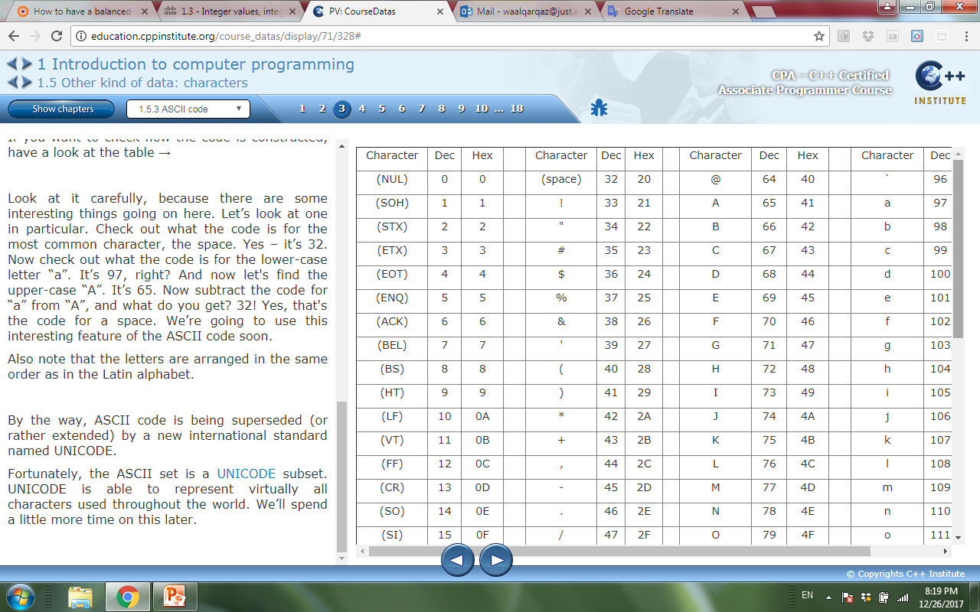
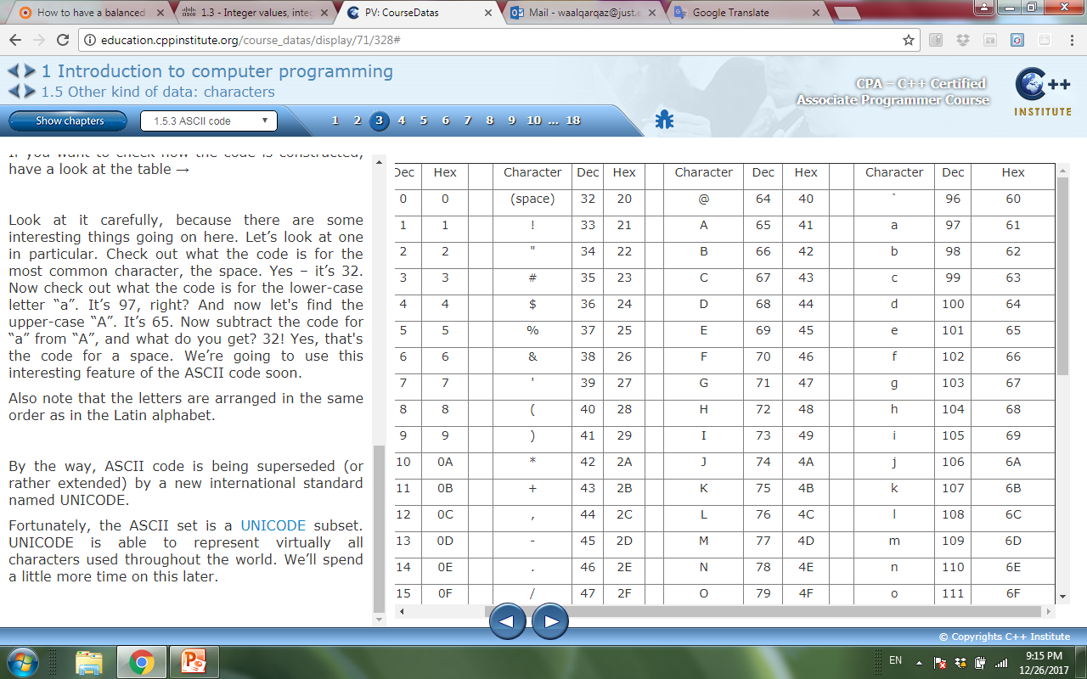
ASSCII Table
the ASCII set is a UNICODE subset. UNICODE is able to represent virtually all characters used throughout the world.

Slide 42
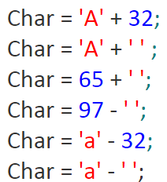
Char values are int values
All of the following assignments are correct.
Answers: 97, 97, 97, 65, 65, 65.

Slide 43
Numbers and how computers see them
The numbers handled by modern computers are of two types:
integers, that is, whole numbers or those which are devoid of the fractional part,
floating-point numbers (or simply floats) that contain (or are able to contain) the fractional part.
Both of these kinds of numbers significantly differ in how they are stored in a computer memory and in the range of acceptable values.
C++ language allows some arithmetic operations with numbers: add, subtract, multiply and divide.

Slide 44
Floating-Point Data Types
The decimal point is essential to recognize floating-point numbers in C++.
4 is an int 4.0 is a float
C++ Programming: From Problem Analysis to Program Design, Fifth Edition
C++ uses scientific notation to represent real numbers (floating-point notation)

Slide 45
Floating-Point Data Types (cont'd.)
C++ Programming: From Problem Analysis to Program Design, Fifth Edition
float: represents any real number
Range: -3.4E+38 to 3.4E+38 (four bytes)
double: represents any real number
Range: -1.7E+308 to 1.7E+308 (eight bytes)
On most newer compilers, data types double and long double are same
int i, z; float x, w;
i = 10/4 ; //i =2
x = 10.0 / 4.0; //x=2.5
w = 10.0 / 4; //w= 2.5
z = 10.0 / 4; //z=2

Slide 46
Floating-Point Data Types (cont'd.)
C++ Programming: From Problem Analysis to Program Design, Fifth Edition
Maximum number of significant digits (decimal places) for float values is 6 or 7
Maximum number of significant digits for double is 15
Precision: maximum number of significant digits
Float values are called single precision
Double values are called double precision
The scientific notation can be used to represent numbers that are very large or very small
Examples : 300000000 → 3E8 6.62607 X 10⁻³⁴ → 6.62607E-34
The exponent (the value after the “E”) must be an integer.
The base (the value in front of the “E”) may or may not be an integer.

Slide 47
1.4 Floating-point numbers
What happens when integer values converted into float values or vice versa?
We can always transform from int into float.
For example:
int i ;
float f;
i=100;
f=i;
the value of the variable i will be 100.
the value of the variable f is 100.0

Slide 48
1.4 Floating-point numbers
We can always transform from float into int, but it can lead to a loss of accuracy.
For example:
int i ;
float f;
f=100.25 ;
i=f;
the value of the variable i will be 100
the value of the variable f will be 100.25

Slide 49
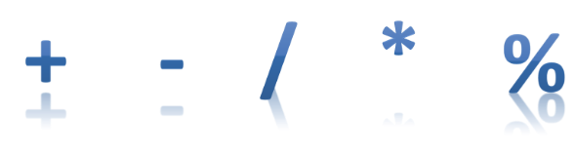
1.4 Operators
An operator is a symbol of the programming language, which is able to operate on the values
For example, an assignment operator is (=)
Used to assign values to variables X= 4
Other operators available in C++ language associated with widely recognizable arithmetic operations.

Slide 50
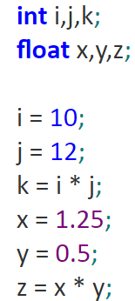
1.4 Multiplication ( * )
An asterisk * is a multiplication operator.
For example:
k will be set to the value of 120, while the z variable will be set to 0.625.

Slide 51
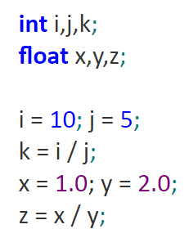
1.4 Division ( / )
A slash / is a divisional operator. The value in front of the slash is a dividend, while the value behind the slash is a divisor.
For example:
k will be set to 2, z to 0.5.

Slide 52
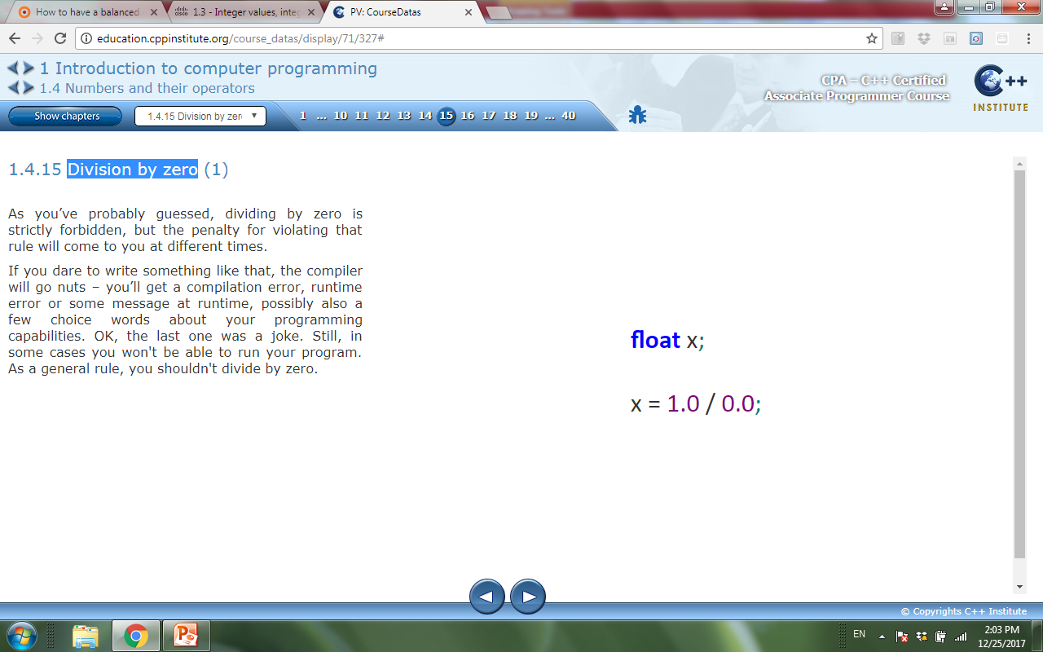
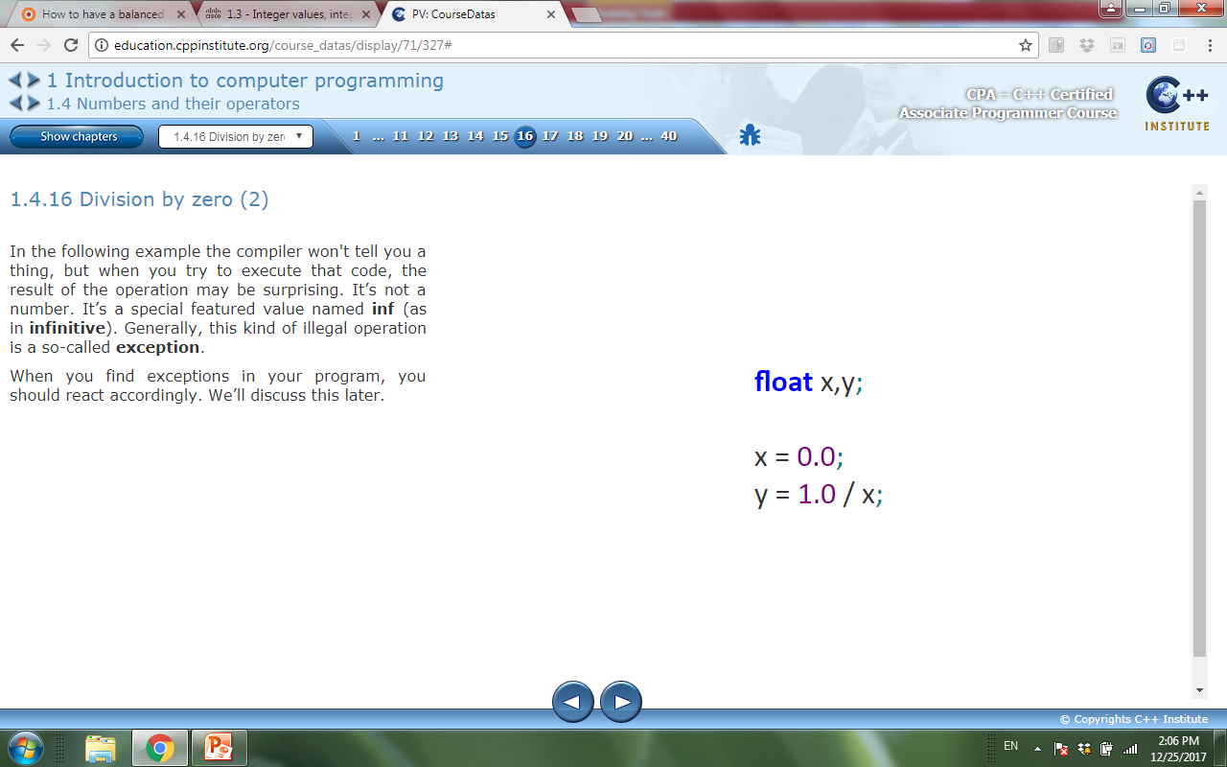
1.4 Division by zero
This will result with a compilation error, runtime error or some message at runtime. As a general rule, you shouldn't divide by zero.
For example:
And the code:
when you try to execute that code, the result of the operation is not a number. It’s a special featured value named inf (as in infinitive). Generally, this kind of illegal operation is a so-called exception.

Slide 53
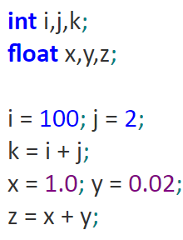
1.4 Addition ( + )
The addition operator is the + (plus) sign.
For example:
k is equal to 102 and z to 1.02..

Slide 54
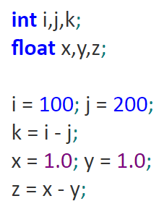
1.4 Subtraction( - )
The subtraction operator is the – (minus) sign.
this operator has another meaning – it can change the sign of a number.
For example:
k will be equal to -100, while z will be equal to 0.0.

Slide 55
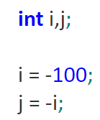
1.4 Unary minus ( - )
In “subtracting” applications, the minus operator expects two arguments: the left (a minuend in arithmetical terms) and right (a subtrahend).
For this reason, the subtraction operator is considered to be one of the binary operators, just like the addition, multiplication and division operators.
The minus operator used as the unary operator, as it expects only one argument - the right one.
For example:
The variable j will be assigned the value of 100.

Slide 56
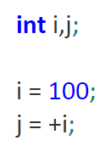
1.4 Unary plus (+)
Its role is to preserve the sign. Take a look at the snippet
Although such a construction is syntactically correct, using it doesn’t make much sense and it would be hard to find a good rationale for doing it.
For example:
The variable j will be assigned the value of 100.

Slide 57
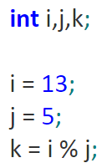
1.4 Remainder ( % )
Its representation in the C++ language is the % (percent) character.
It’s a binary operator (it performs the modulo operation) and both arguments cannot be floats.
For example:
The k variable is 3 (because 2 * 5 + 3 = 13).

Slide 58
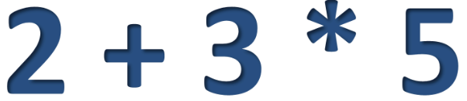
1.4 Priorities
The hierarchy of priorities is the phenomenon that causes some operators to act before others is known as the priority.
The C++ language precisely defines the priorities of all operators and assumes that operators of larger (higher) priority perform their operations before the operators with lower priority.
For example:
The result will be 17.

Slide 59
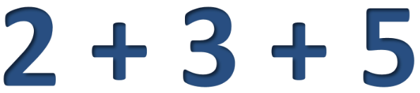
1.4 Bindings
The binding of the operator determines the order of computations performed by some operators with equal priority, put side by side in one expression.
Most operators in the C++ language have the left-sided binding, which means that the calculation of this sample expression is conducted from left to right.
For example:
3 will be added to 2, and 5 will be added to the result.

Slide 60
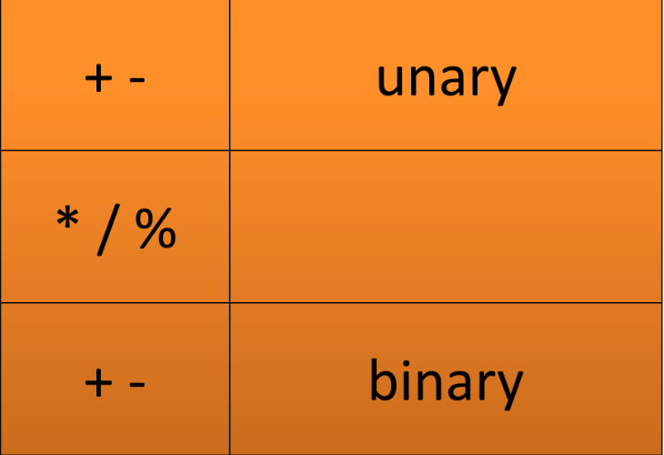
1.4 List of priorities
Priorities from the highest to the lowest priority.

Slide 61
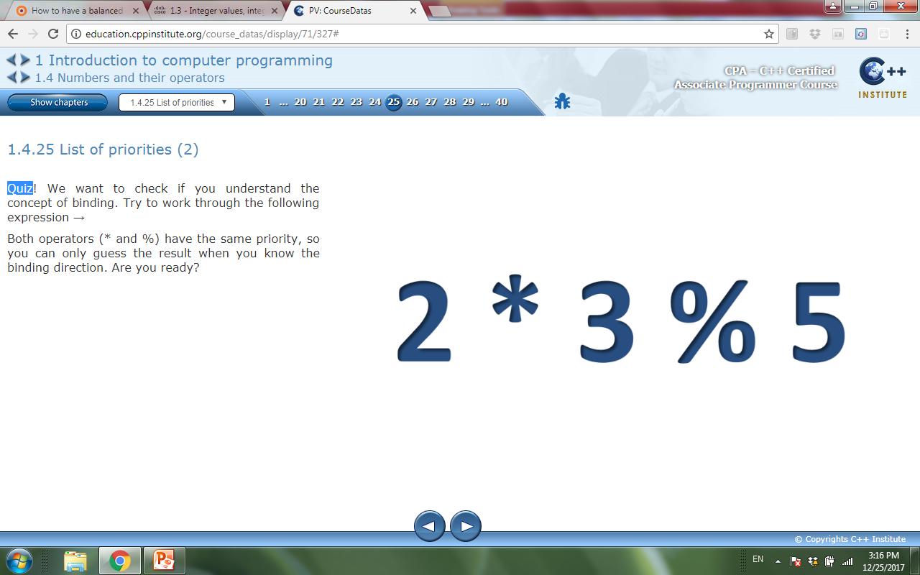
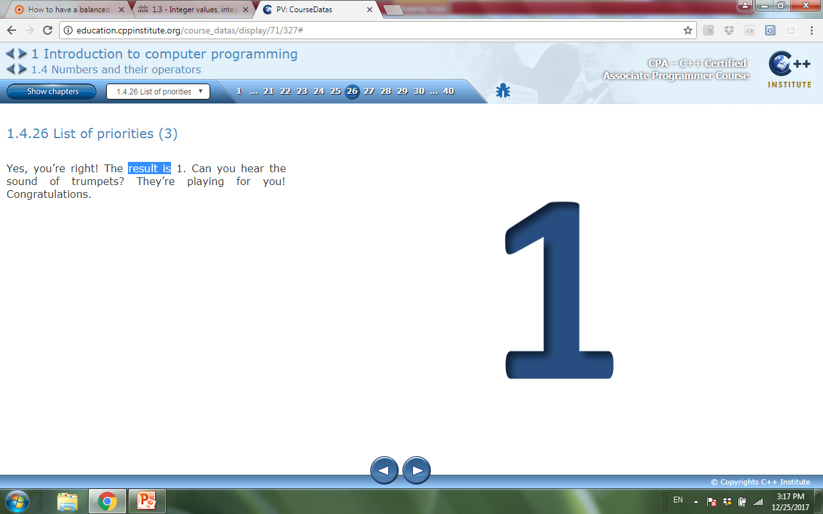
1.4 List of priorities
Quiz
Result is:

Slide 62
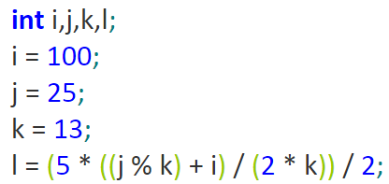
1.4 Parentheses
Parentheses can change the natural order of calculation. Sub expressions in parentheses are always calculated first.
You can use as many parentheses as you need and we often use them to improve the readability
For example:
I will take 10.

Slide 63
Expressions
C++ Programming: From Problem Analysis to Program Design, Fifth Edition
If all operands are integers
Expression is called an integral expression
Yields an integral result
Example: 2 + 3 * 5
If all operands are floating-point
Expression is called a floating-point expression
Yields a floating-point result
Example: 12.8 * 17.5 - 34.50

Slide 64
Mixed Expressions
C++ Programming: From Problem Analysis to Program Design, Fifth Edition
Mixed expression:
Has operands of different data types
Contains integers and floating-point
Examples of mixed expressions:
2 + 3.5
6 / 4 + 3.9
5.4 * 2 – 13.6 + 18 / 2
If operator has both types of operands
Integer is changed to floating-point

Slide 65
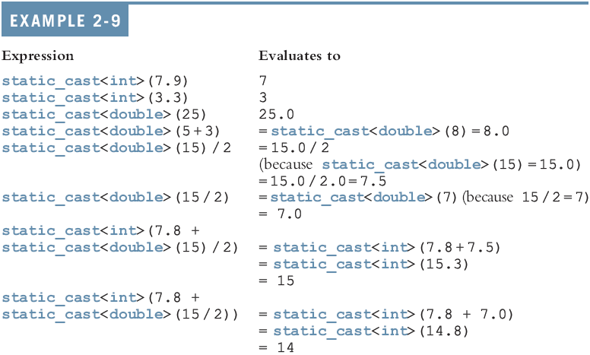
Type Conversion
Cast operator: provides explicit type conversion
static_cast<dataTypeName>(expression)
C++ Programming: From Problem Analysis to Program Design, Fourth Edition
65

Slide 66
string Type
Programmer-defined type supplied in ANSI/ISO Standard C++ library
Sequence of zero or more characters
Enclosed in double quotation marks
Null: a string with no characters
Each character has relative position in string
Position of first character is 0
Length of a string is number of characters in it
Example: length of "William Jacob" is 13
string x;
x= “Hello World20 ?”; //15 characters
C++ Programming: From Problem Analysis to Program Design, Fifth Edition

Slide 67
1.4 Increment Operator ( ++ )
Used to increment a variable by one.
This is often done when we’re counting something .
For example:
int Counter;
Counter = 0;
Counter = Counter + 1;
We achieve the same effect in a shorter way:
Counter++;

Slide 68
1.4 Decrement Operator ( -- )
Used to decrease the value of a chosen variable by one.
This is often done when we’re counting something .
For example:
int Counter;
Counter = 10;
Counter = Counter - 1;
We achieve the same effect in a shorter way:
Counter--;

Slide 69
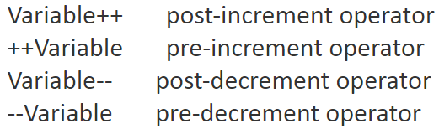
1.4 Increment and Decrement Operators
Both operators can be used as postfix and prefix operators with the same effect to increment or decrement a given variable by 1 called Pre/post increment/decrement operators.
For example:

Slide 70
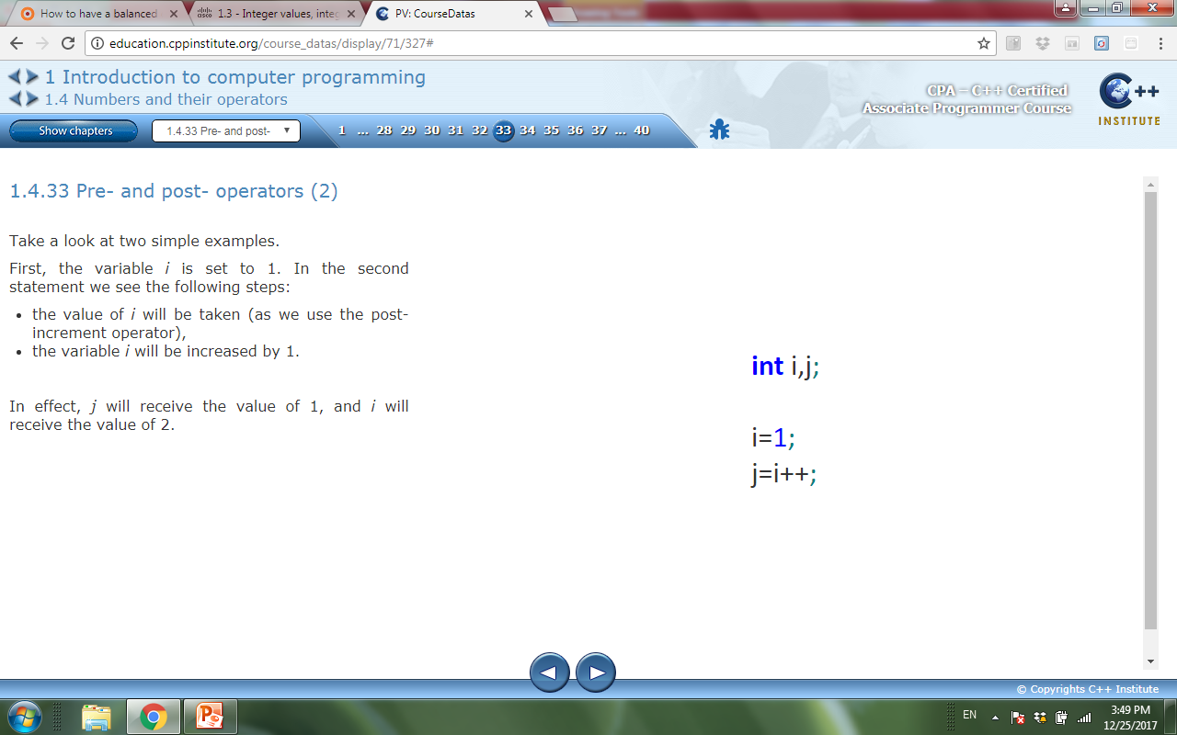
1.4 Increment and Decrement Operators
There is a fairly significant difference between prefix and postfix.
Operation: Variable++ Variable--
Effect: Use the original (unchanged) variable's value and then increment/decrement the variable by 1.
For example:
The variable i is set to 1. In the second statement : the value of i will be taken (as we use the post-increment operator), then the variable i will be increased by 1.
In effect, j will receive the value of 1, and i will receive the value of 2.

Slide 71
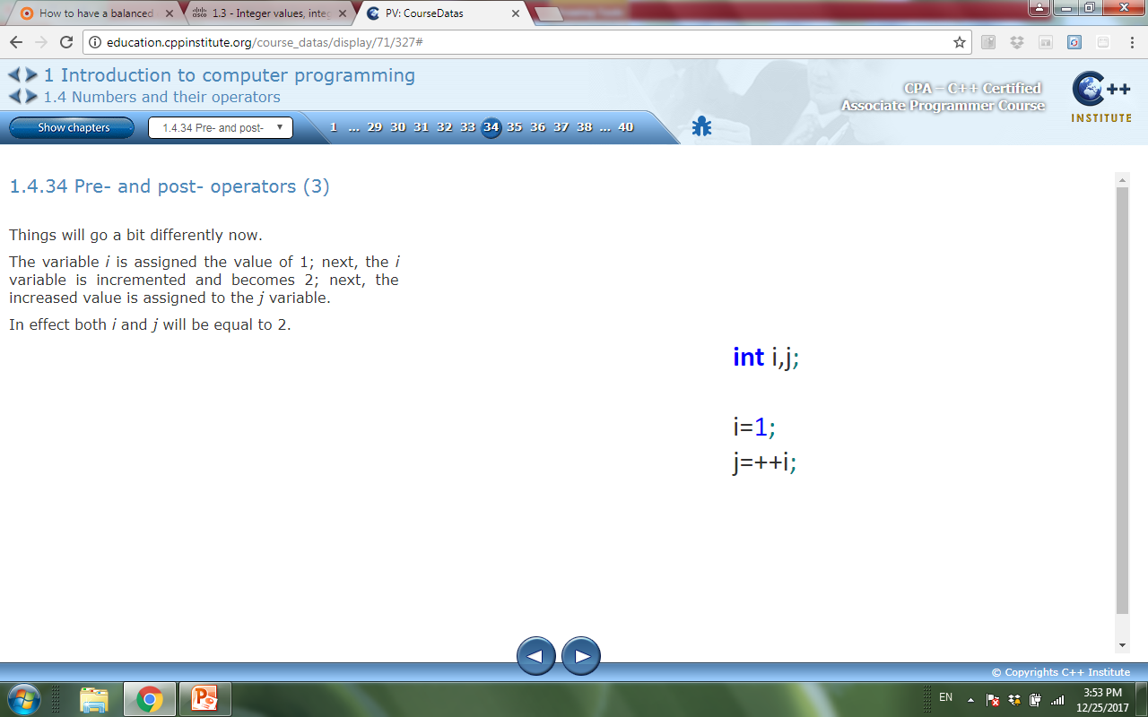
1.4 Increment and Decrement Operators
There is a fairly significant difference between prefix and postfix.
Operation: ++Variable --Variable
Effect: Increment/decrement the variable by 1 and use its value already increased/reduced.
For example:
The variable i is assigned the value of 1; next, the I variable is incremented and becomes 2; next, the increased value is assigned to the j variable.
In effect both i and j will be equal to 2.

Slide 72
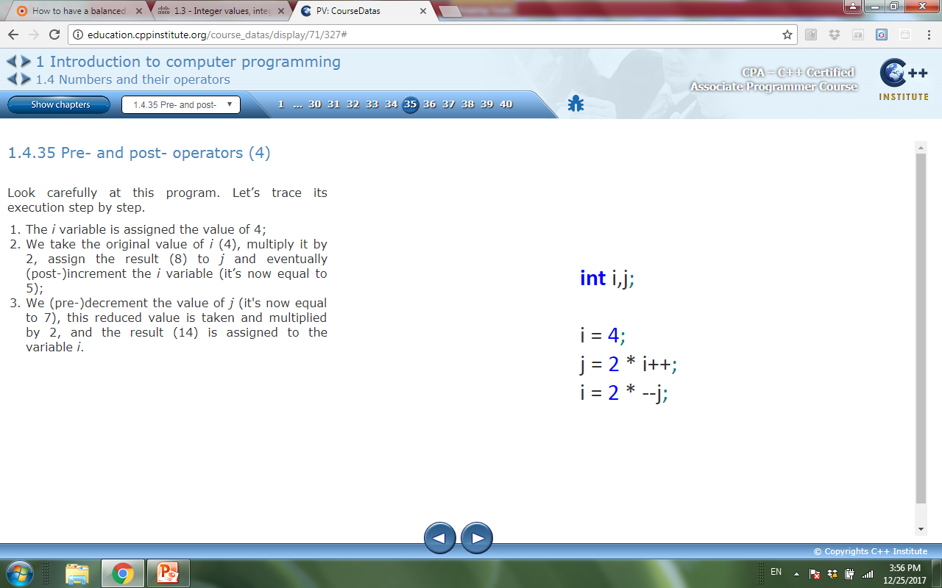
1.4 Increment and Decrement Operators
Example:
The program execution step by step:
The i variable is assigned the value of 4;
We take the original value of i (4), multiply it by 2, assign the result (8) to j and eventually (post-)increment the i variable (it’s now equal to 5).
We (pre-)decrement the value of j (it's now equal to 7), this reduced value is taken and multiplied by 2, and the result (14) is assigned to the variable i.

Slide 73
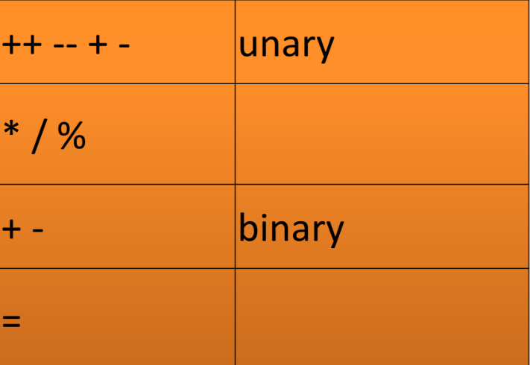
1.4 Pre- and post- operators (priorities)

Slide 74
1.4 Shortcut operators
In the C++ language there is a short way to write the operators.
If op is a two-argument operator and the operator is used in the following context:
variable = variable op expression;
It can be simplified and shown as follows:
variable op = expression;
For example:
i=i*2; → i *= 2 ;
counter = counter + 10; → counter +=10;

Slide 75
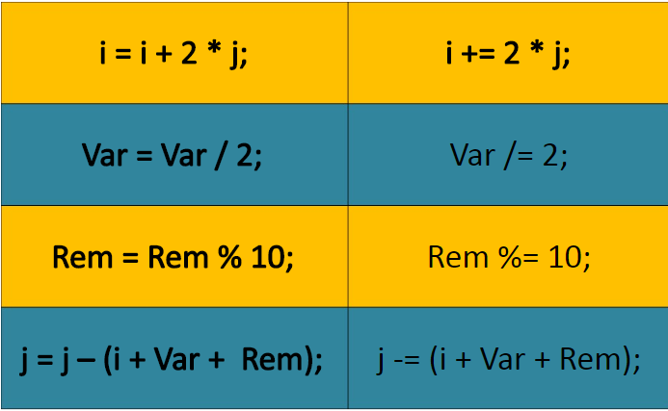
1.4 Shortcut operators

Slide 76
1.4 Activity
Lab 1.4.2 (1) Floats: operators and expressions [A]
Lab 1.4.40 (1) Ints: operators and expressions [A]
Lab 1.4.40 (2) Parentheses [A]

Slide 77
1.5 Character and Literals
char is a type
literal is a symbol that uniquely identifies its value
Examples:
char Character = ‘A’
char A = 100
Character: this is not a literal; it’s a variable name
'A‘ : this is a literal; when you look at it you immediately know its value
100 : it's a literal, too (of type int)
100.0 : it's another literal, this time of the float type
i + 100 : this is a combination of a variable and a literal joined together with the + operator; such a structure is called an expression.

Slide 78
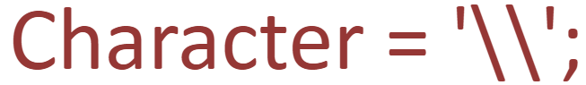
1.5 Character literals
The C++ language uses a special character backslash( \)
it named as escape character because by using the \ we escape from the normal meaning of the character that follows the slash
You can also use the escape character to escape from the escape character.
For example:

Slide 79
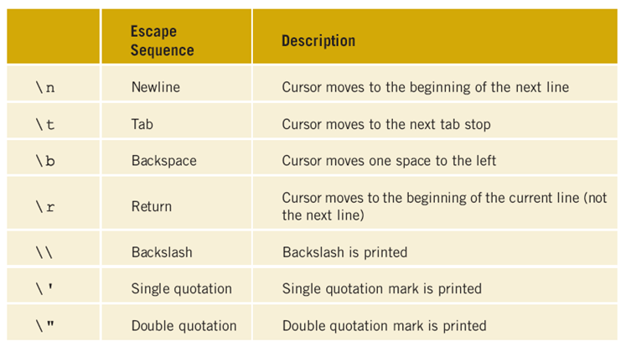
1.5 Escape characters

Slide 80
1.5 Escape characters
The C++ language use escape character to denote literals representing white spaces.
\n : denotes a transition to a new line and is sometimes called an LF (Line Feed).
\r : denotes a return to the beginning of the line and is sometimes called a CR (Carriage).
\a : as in alarm if you send this character to the screen, you’ll hear a short beep.
\0 : called null (none) is a character that does not represent any character.

Slide 81
1.6 Flow control: how to make simple decisions?

Slide 82
1.6 Relational operators
To ask questions, the C++ language uses a set of very special operators called relational operators.
The result from expressions that use relational operators will be true or false.

Slide 83
Relational Operators
A condition is represented by a logical (Boolean) expression that can be true or false
Relational operators:
Allow comparisons
Require two operands (binary)
Evaluate to true or false
C++ Programming: From Problem Analysis to Program Design, Fourth Edition

Slide 84
Relational Operators (continued)
C++ Programming: From Problem Analysis to Program Design, Fourth Edition

Slide 85
Relational Operators and Simple Data Types
C++ Programming: From Problem Analysis to Program Design, Fourth Edition
You can use the relational operators with all three simple data types:
8 < 15 evaluates to true
6 != 6 evaluates to false
2.5 > 5.8 evaluates to false
5.9 <= 7.5 evaluates to true

Slide 86
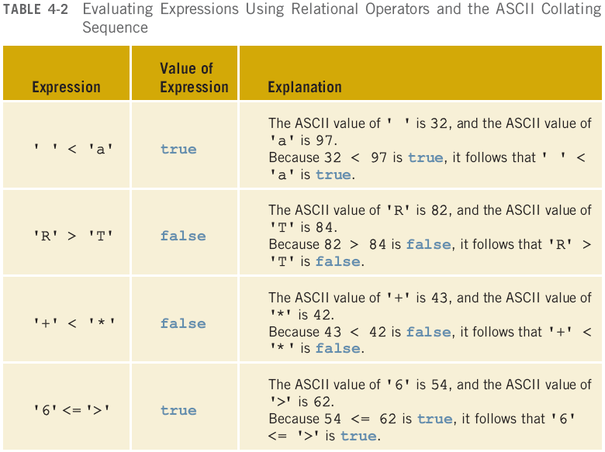
Comparing Characters
C++ Programming: From Problem Analysis to Program Design, Fourth Edition

Slide 87
Relational Operators and the string Type
Relational operators can be applied to strings
Strings are compared character by character, starting with the first character
Comparison continues until either a mismatch is found or all characters are found equal
If two strings of different lengths are compared and the comparison is equal to the last character of the shorter string
The shorter string is less than the larger string
C++ Programming: From Problem Analysis to Program Design, Fourth Edition

Slide 88
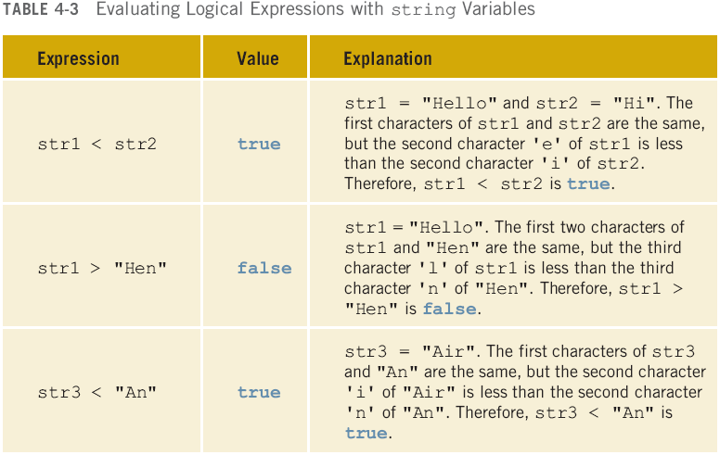
string str1 = "Hello";
string str2 = "Hi";
string str3 = "Air";
string str4 = "Bill";
string str4 = "Big";

Slide 89
Logical (Boolean) Operators and Logical Expressions
Logical (Boolean) operators enable you to combine logical expressions
unary
binary
binary
C++ Programming: From Problem Analysis to Program Design, Fourth Edition

Slide 90
Logical (Boolean) Operators and Logical Expressions (continued)
C++ Programming: From Problem Analysis to Program Design, Fourth Edition

Slide 91
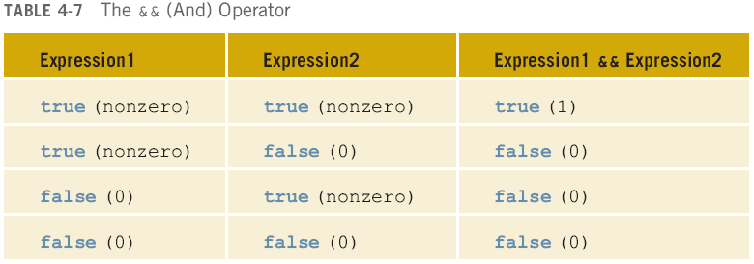
C++ Programming: From Problem Analysis to Program Design, Fourth Edition

Slide 92
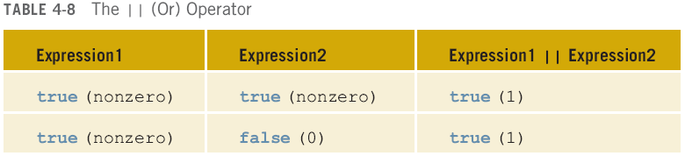
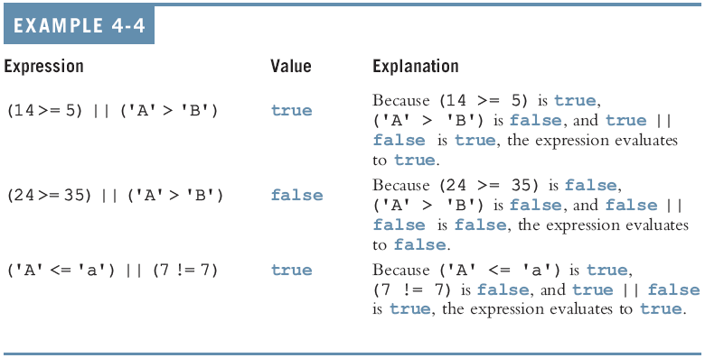
C++ Programming: From Problem Analysis to Program Design, Fourth Edition

Slide 93
Order of Precedence (continued)
C++ Programming: From Problem Analysis to Program Design, Fourth Edition

Slide 94
1.6 Conditions and conditional executions
There are several variants of conditional instruction
One-Way Selection
Compound (Block of) Statements
Two-Way Selection
Multiple Selections: Nested if
Comparing if...else Statements with a Series of if Statements
In this chapter we will focus on the first and the second forms

Slide 95
One-Way Selection
C++ Programming: From Problem Analysis to Program Design, Fourth Edition
The syntax of one-way selection is:
The statement is executed if the value of the expression is true
The statement is bypassed if the value is false; program goes to the next statement
if is a reserved word

Slide 96
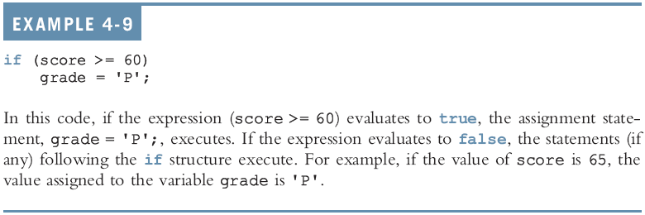
One-Way Selection (continued)
C++ Programming: From Problem Analysis to Program Design, Fourth Edition

Slide 97
One-Way Selection (continued)
C++ Programming: From Problem Analysis to Program Design, Fourth Edition

Slide 98
Confusion Between == and =
C++ Programming: From Problem Analysis to Program Design, Fourth Edition
C++ allows you to use any expression that can be evaluated to either true or false as an expression in the if statement:
if (x = 5)
cout << "The value is five." << endl;
The appearance of = in place of == resembles a silent killer
It is not a syntax error
It is a logical error

Slide 99
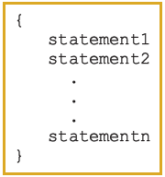
Compound (Block of) Statement
When we have to execute conditionally more than one instruction, we need to use the braces { and }which create a structure known as a compound statement or (much simpler) a block.
The compiler treats the block as a single instruction.
C++ Programming: From Problem Analysis to Program Design, Fourth Edition
Compound statement (block of statements):
A compound statement is a single statement

Slide 100
1.6 Activity
Lab 1.6.11 (1) Logical data: operators and expressions [A]

Slide 101
1.7 Connecting with the real world: input and output

Slide 102
1.7 Input and output
When data moves in the direction of the human (user) to the computer program, it’s called the input
cin stream, used with the >> operator to insert data.
The >> operator itself is sometimes referred to as an insertion operator.
The data transferred from the computer to the human, is called the output.
cout stream, used with the << operator to output data.
The << operator itself is sometimes referred to as an insertion operator.

Slide 103
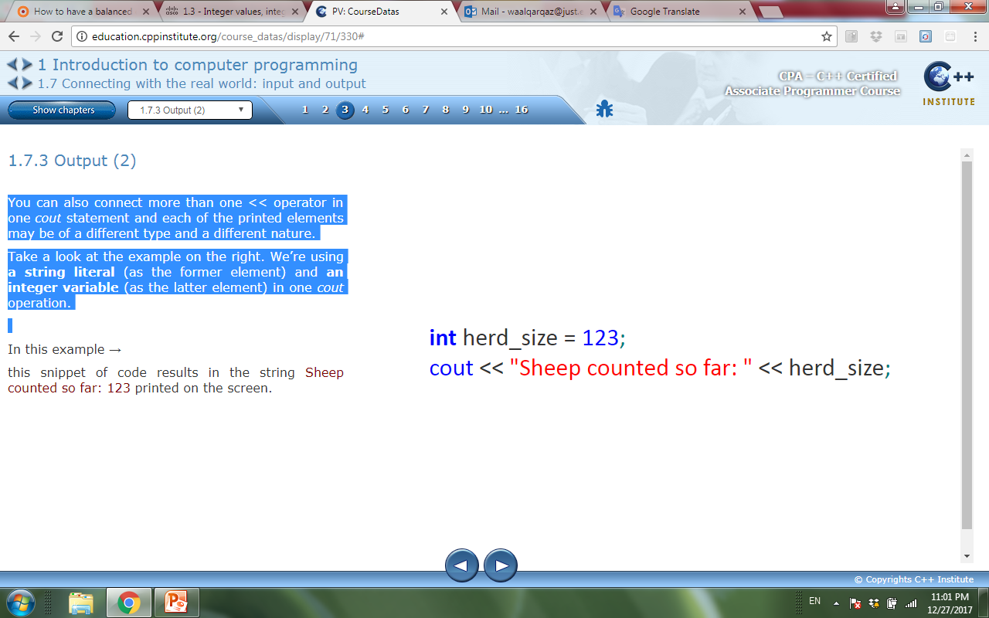
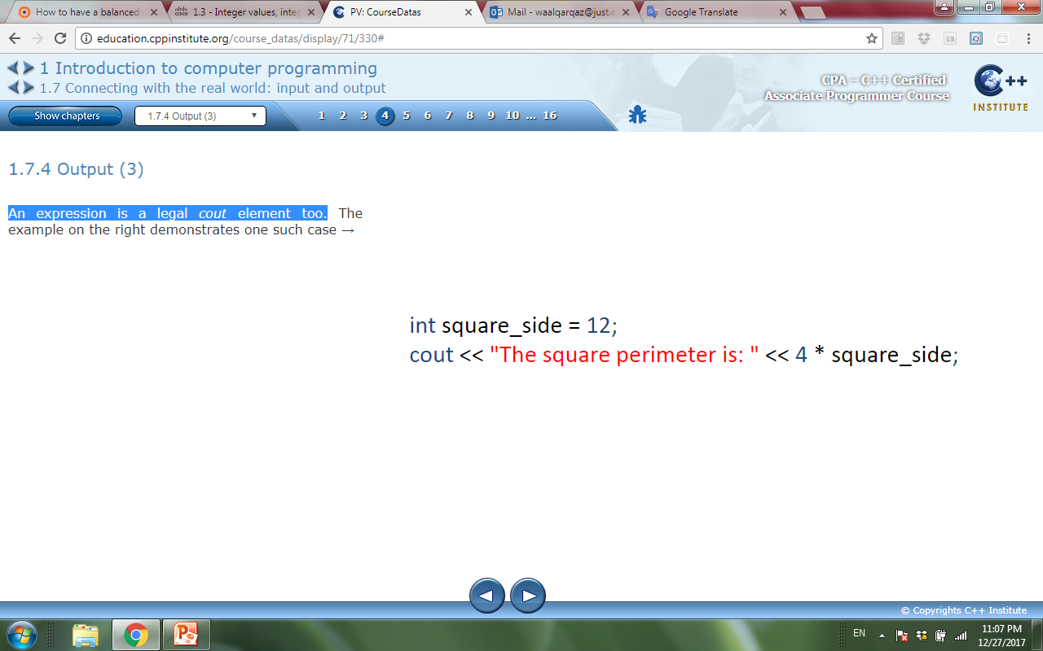
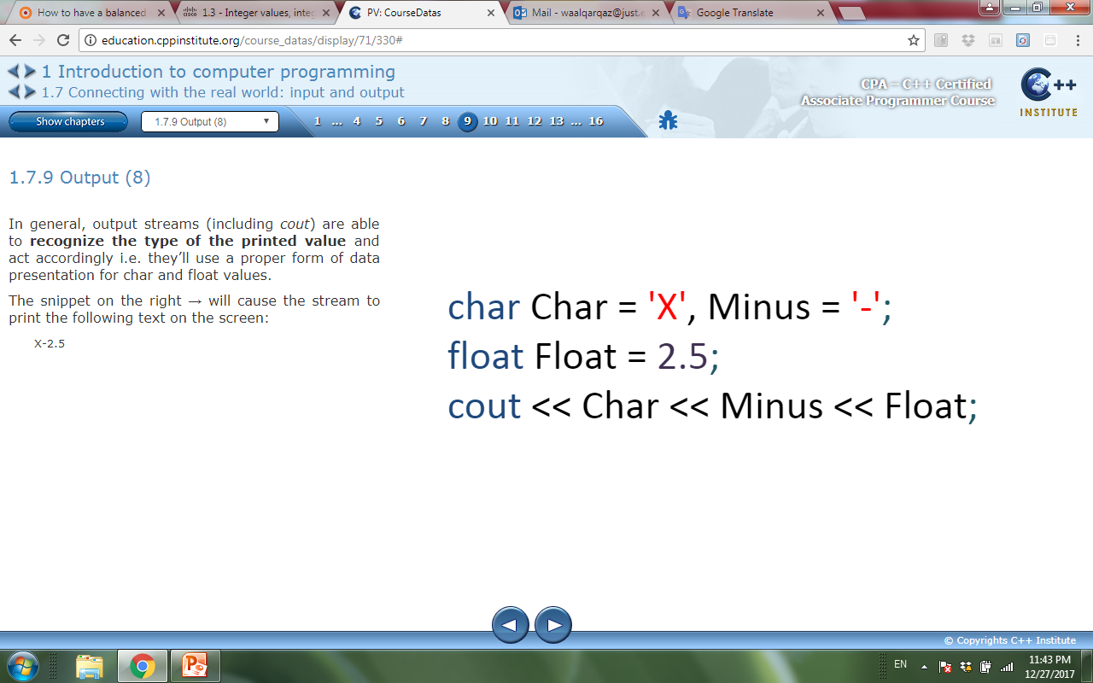
1.7 output
To print the value of an integer variable we need to send it to cout stream through << operator
Both the << operator and cout stream are responsible for printing
You can connect more than one << operator in one cout statement and each of the printed elements may be of a different type and a different nature

Slide 104
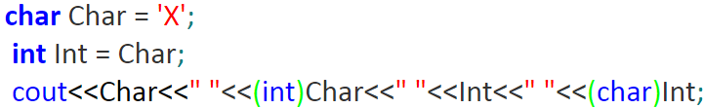
1.7 output
cout is able to recognize the actual type of its element even when it is an effect of a conversion.
A conversion can be done using the syntax: (newtype)expr
Changes the type of the expr expression into the newtype type.
Using this conversion we can see the ASCII code of any character stored within a char variable and vice versa, or see a character whose ASCII code is placed inside an int variable.
For example:
This snippet outputs the following text to the screen: X 88 88 X

Slide 105
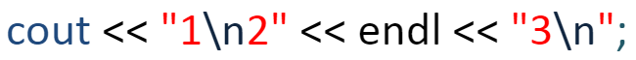
1.7 output
To break the line being sent to the screen using two ways:
First, we can use one of the control characters called “newline” and coded as \n (note: we use two characters to write it down but the compiler sees it as one character).
The newline character forces the console to complete the current line and to start a new one.
Second, using a manipulator called endl (as “end line”). Using endl We can achieve exactly the same effect as \n.
Example:
This snippet causes the console to display the following three lines of text:
1 2 3

Slide 106
1.7 Input
C++ program allow getting information from the user, transfer it to the program, and then use it for calculations.
C++ use cin stream with the operator >>, referred to as an extraction operator.
The cin stream, along with the extraction operator, is responsible for:
transferring the human-readable form of the data from the input device e.g. a console.
converting the data into the internal (machine) representation of the value being input.

Slide 107
1.7 Input
Using cin stream with the operator >>; C++ language program get data from a human and store it in variables.
C++ program can ask the user to enter a value from the keyboard and the program stores it in a specified variable
For example: cin>>MaxPrice;
A difference between cout and cin streams is that the argument for cout may not be a variable. It can also be an expression or constants.
For example: cout << 2 * i;
But using an input stream, we need to explicitly specify the variable that can store the data entered by the user.

Slide 108
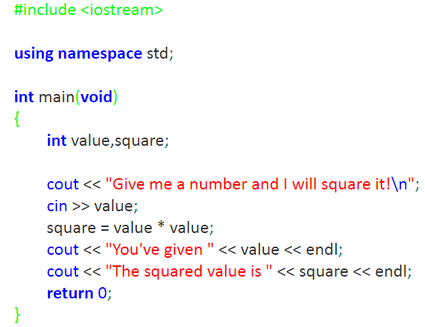
1.7 Input
Example:

Slide 109
1.7 Input
C++ provides a function sqrtf (square root float) that knows how to compute the square root.
This function takes the argument of the float type.
The result is also a float ( The root of any number is not always an integer, like the square root of 2).
to use this function you need to include a header file named cmath.
C++ does not have a square root operator

Slide 110
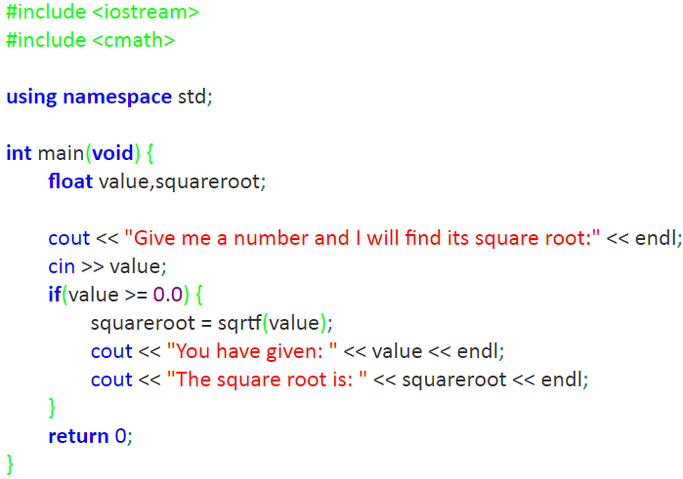
1.7 Input
Example:

Slide 111
1.7 output
C++ outputs float values in the different format and the output streams try to output float values in a form that is more compact, and a decision is taken for every printed float value.
For example:
float x = 2.5, y = 0.0000000025;
cout << x << endl << y << endl;
will produce the following output on the screen:
2.5 → fixed point format.
2.5e-009 →scientific format.
There are two manipulators designed implicitly to choose the desired output depending on the user’s needs and preferences: Their names are:
fixed.
scientific.
Note that initially the streams are set neither to the fixed nor to the scientific mode, but to the default (automatic) mode.

Slide 112
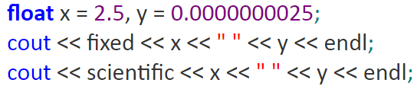
1.7 output
Using any of the two manipulators switches the stream to the desired mode; however, you can’t return to the default method of processing floats by using any of the manipulators.
For example:
The output of this snippet is:
2.500000 0.000000 2.500000e+000 2.500000e-009

Slide 113
1.7 Activities
Lab 1.7.3 (1) Printing data [A]
Lab 1.7.4 (2) Near zero float numbers [A]
Lab 1.7.5 (3) Getting input from user [A]

Slide 114
Skip Slides. . .
Only for Lab

Slide 115
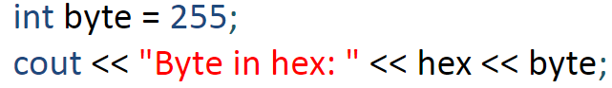
1.7 output
If you want a value of type int to be presented as a fixed-point hexadecimal number, you need to use the so-called a hex manipulator.
Example:
This snippet will output a string consisting of characters ‘f’ and ‘f’.
A manipulator is a special kind of entity that tells the stream that the data form has to be changed. All elements outputted after the manipulator activation will be presented in the desired form.

Slide 116

1.7 output
Example:
The snippet will output the three specimens of the same value: FF as a hexadecimal representation of 255 (as an effect of the hex manipulator) FF again (the previous hex activation is still 255 (as a result of the dec manipulator activation)
Note: the dec manipulator switches the stream into a decimal form. We don’t have it explicitly in most cases, since the decimal is the default working mode for output streams.

Slide 117

1.7 output
Example:
This snippet will output ‘377’ to the screen.
The oct manipulator switches the stream into the octal mode.

Slide 118

1.7 output
setbase manipulator, directly instructs the stream on what base value it should use during conversion.
The only acceptable values for the setbase parameter are 8, 10 and 16.
Example:
setbase manipulator requires a header file called iomanip

